Slide 1
Why Erlang?
@KeithElder
http://keithelder.net
Director, Software Engineering
Quicken Loans
Deck/Demo available @ http://github.com/keithelder

Slide 2
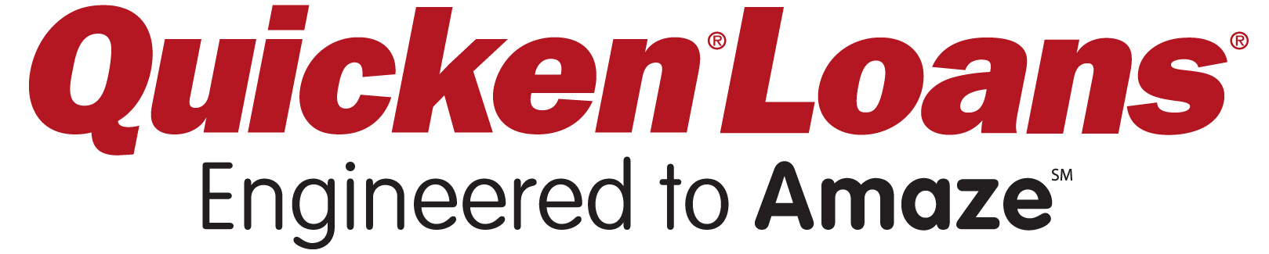
Thank you!
Notes:
Thank you to my employer for allowing me to come out and speak on some of the things we’re doing @QLTechnology

Slide 3
MY GOALS
Why we started looking at Erlang
For OOP devs What makes Erlang different and interesting at solving certain problem domains
Show you Why you should look at Erlang too

Slide 4
Disclaimers
Keith is not an Erlang expert
Keith is not here to tell you to ERLANG ALL THE THINGS
Keith is here to tell you a story, after hearing it choose to act upon it or not

Slide 5
How I arrived at erlang
A quick architecture lesson, sort…of…

Slide 6

Web Request
Web Server
Blog Architecture
Database
Fetch Data

Slide 7
Web Request
Enterprise Blog Architecture
Web Server
Database
Cache

Slide 8
Web Request
Load Balancer
Super Enterprise Blog Architecture
Web Farm
Fetch Data
Database Cluster
Cache Cluster
Notes:
Even though there are countless applications built using the architecture in these last 3 slides, those applications are still not setup to provide end users what they really want.
And these applications are setup to not scale and handle large bursts of traffic and long running business transactions. Parts of the system are going to fail as we’ll look at and there is no way to recover them either.
Here’s a question though.

Slide 9
QUESTION: What has happened in the last several years that end-users have figured out we could have been giving them all along on the web?

Slide 10
Real-time Updates and Push Notifications

Slide 11

He exposed our secret to the world.

Slide 12
Billions of more messages!

Slide 13
Services
Architecture
Get curly braces (data)
Web Cluster
Fetch Data
Database
REST API
Cache
Notes:
As web developers we’ve finally realized we need an API for our apps. Smart Client devs have known this all along. And by API we don’t mean SOAP APIs either as those were never meant to work on the web.
So we started recently creating a services architecture into our apps.

Slide 14
Web Server
Get angle brackets (html)
Queued Services
Architecture
Get curly braces (data)
Fetch Data
REST API
Database
Queue
Pub/Sub
Cache
Backend Service
Notes:
We no longer build single monolithic applications any longer. Anyone caught doing so shall be terminated immediately.
Adding another level of abstraction with queues gives us the ability to do some pretty amazing things.

Slide 15
Too hard to trouble shoot, complex deployments and too many dependencies!
QUEUED SERVICES ARCHITECTURES

Slide 16
Web Server
Get angle brackets (html)
ERLANG
Get curly braces (data)
Fetch Data
REST API
Database
Queue
Pub/Sub
Cache
Backend Service
Notes:
We no longer build single monolithic applications any longer. Anyone caught doing so shall be terminated immediately.
Adding another level of abstraction with queues gives us the ability to do some pretty amazing things.

Slide 17
Erlang in a tweet
Erlang: a battle-hardened, X-platform, functional language that makes writing reliable, concurrent, distributed systems a joy.

Slide 18
Where Erlang is Used
Automotive, Gaming, Finance, Robots, Cars, Drone software (updates drone while flying), Health Care, Infrastructure, Social Networks, Media (Huffington Post, Boston Globe), Messaging

Slide 19
A FEW ERLANG USE CASES

Slide 20

$19 Billion

Slide 21

(Sept 23rd, 2011)
$ netstat -an | grep -c EST 1016313
1,016,313
Notes:
http://blog.whatsapp.com/170/ONE-MILLION%21?p=170

Slide 22
(Jan 6th, 2012)
jkb@c123$ sysctl kern.ipc.numopensockets kern.ipc.numopensockets: 2277845
2,227,845
Notes:
http://blog.whatsapp.com/196/1-million-is-so-2011

Slide 23
CPU: 37.9% user, 0.0% nice, 13.6% system, 6.6% interrupt, 41.9% idle Mem: 35G Active, 14G Inact, 18G Wired, 4K Cache, 9838M Buf, 27G Free
Notes:
http://blog.whatsapp.com/196/1-million-is-so-2011

Slide 24
WhatsApp
50 Billion msgs / day
578, 703 / second
450 million users
9 months ago 200 million users (fastest growth in history)
2.8 million connections per server
32 Engineers
14 million users per Engineer, unheard of in industry
$0 in marketing

Slide 25
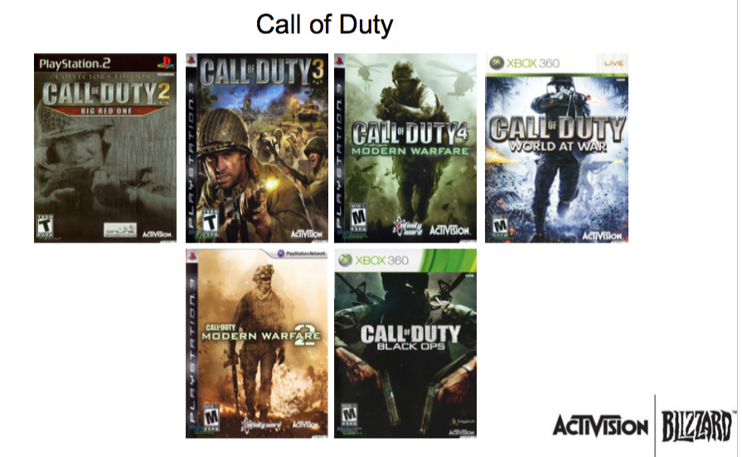

Slide 26
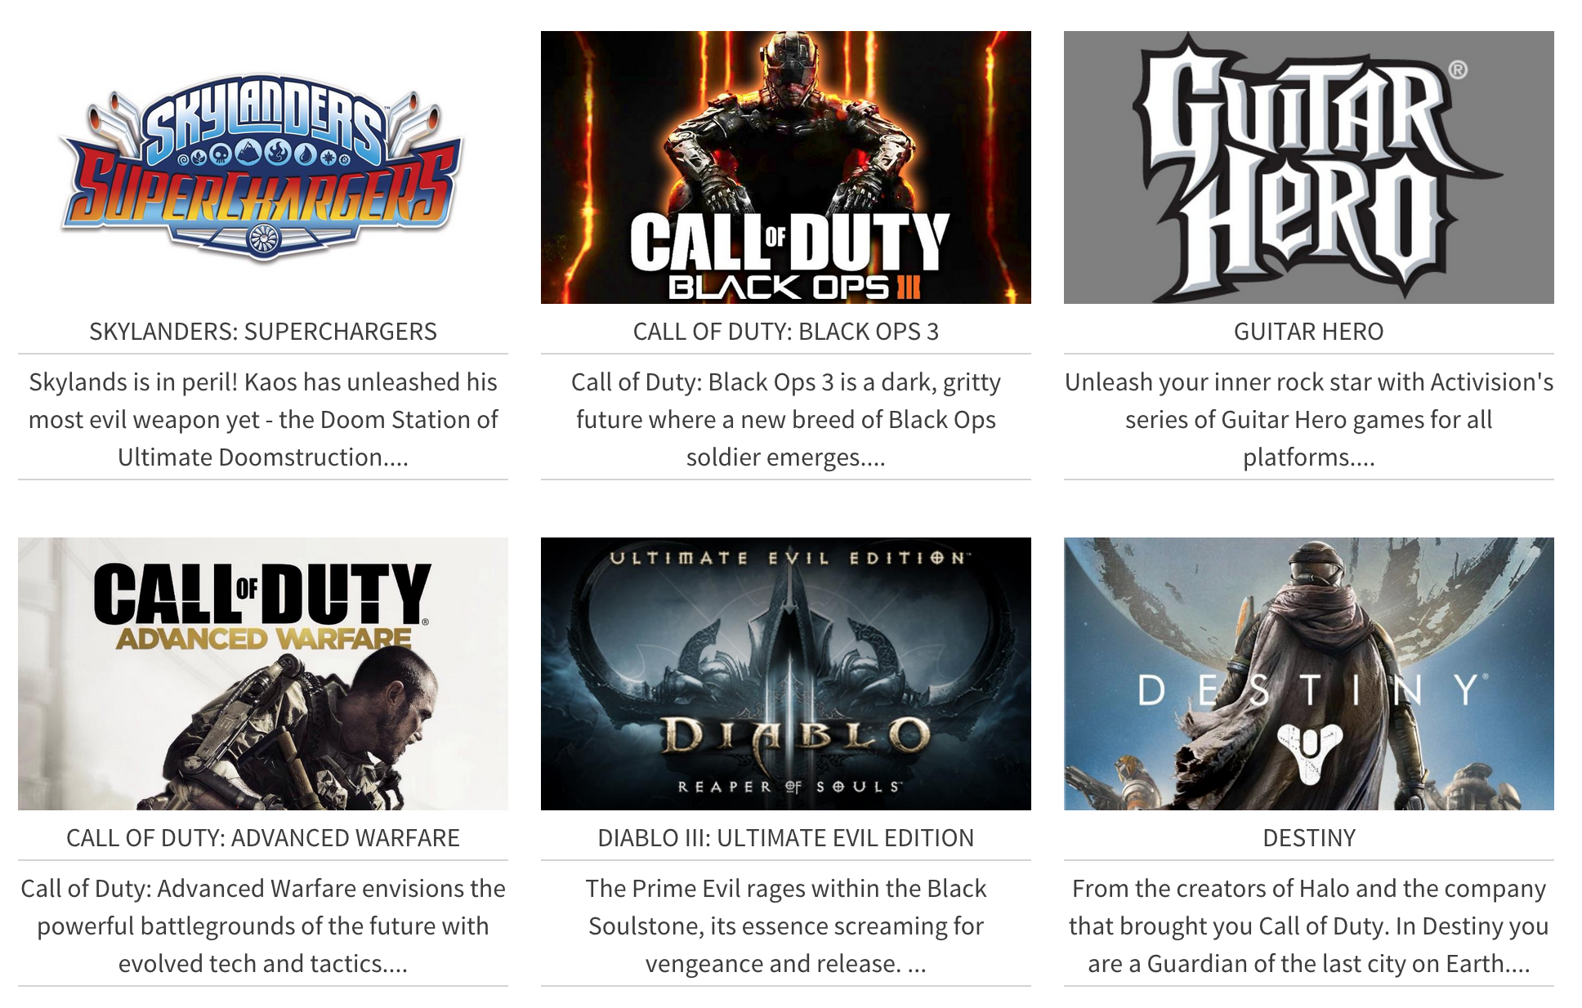

Slide 27
demonware
The backend for online games.

Slide 28
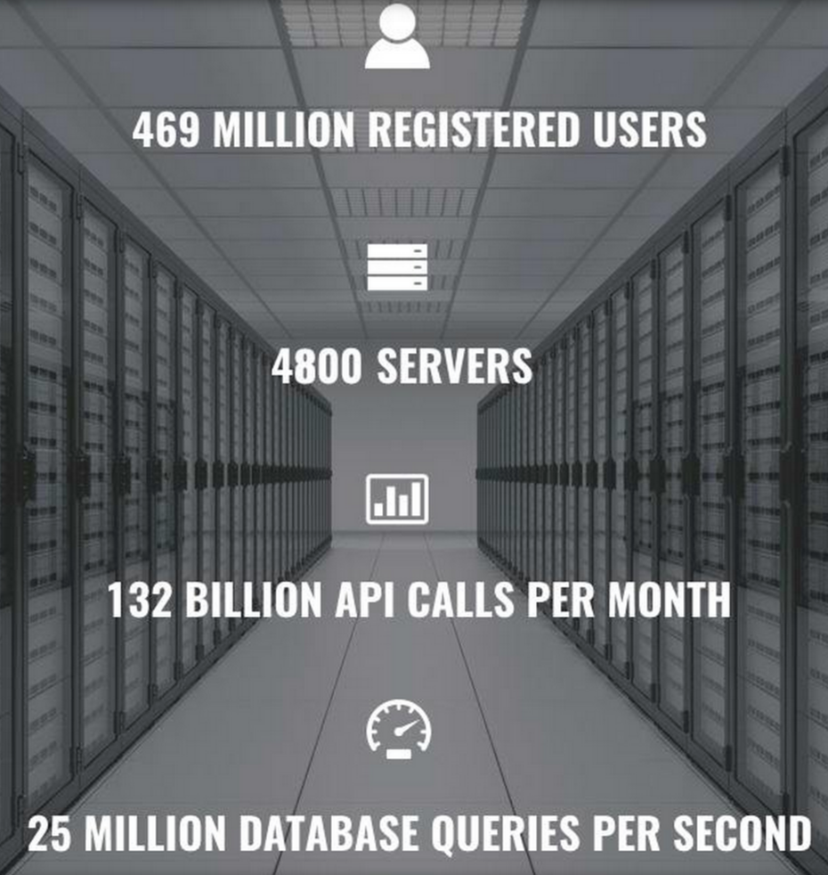
Notes:
Updated as of Aug 9th, 2015.

Slide 29
DemonWare
Initial build out was in C++/Python
Migrated from C++ to Erlang because
C++ is wrong language for concurrency
Code is impossible to maintain
Poor error handling / debugging /metrics / scalability
Had to disconnect all users to change configuration

Slide 30
DemonWare
Wins moving to Erlang
Robust: didn’t crash
Easier configuration
Able to do real time configuration and not affect clients
Better logging / administration tools
Faster to develop features, far fewer lines of code

Slide 31


Slide 32
Motorola Case Study
They wrote a C++/C, Erlang/C, and pure Erlang system. All did the same thing. Here are some of their findings.
Throughput (higher is better)
C++ - 480
Erlang/C – 230
Pure Erlang – 940

Slide 33
Motorola Case Study
Productivity & Maintainability
Shorter programs are
Faster to develop
Contain fewer errors
Easier to maintain
Metric is Source Lines of Code

Slide 34
Motorola Case Study

Slide 35
Why So Much Less?
Erlang programmers can
Rely on fault tolerance
27% of C++ is defensive programming
And have
Automatic memory management (11% of C++)
High level communication (23% of C++)

Slide 36
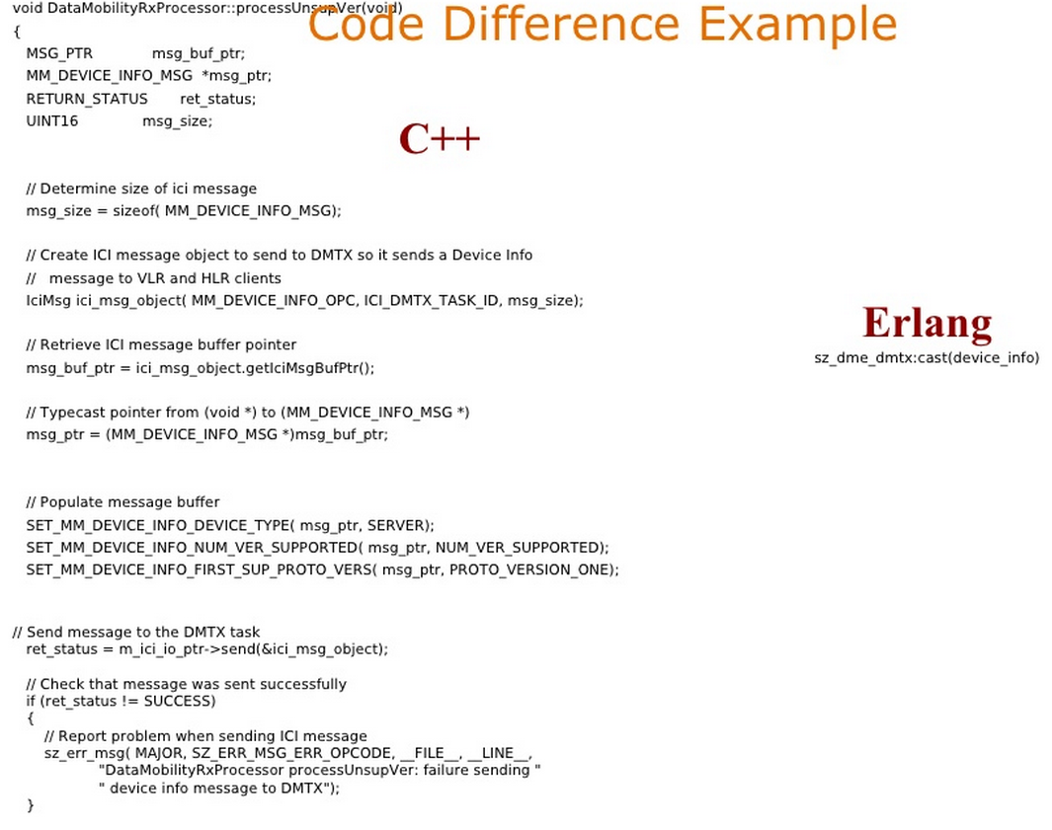

Slide 37
Erlang Problem Domains
Systems can’t fail
Systems need to be distributed
Systems need support for fault tolerance
Systems need to be upgraded while the app is running
System maintenance should be performed without stopping the system
Systems should handle a large number of concurrent activities

Slide 38


Slide 39
demo
Hello World

Slide 40
Erlang ins and outs

Slide 41
Erlang Quick Facts
Joe Armstrong, Robert Virding & Mike Williams in 1986
Released as open source in 1998
Erlang/OTP
Open Telephone Platform
Includes
Dialyzer – static analysis tool
Mnesia – distributed database

Slide 42
Erlang Basic Principles
Lightweight Concurrency
Immutability
Fault isolation and self healing
No shared data
Dynamic
Provide tools for building systems not solutions

Slide 43
Result
Functional language
Dynamically typed (but still compiled)
No user defined types
Built in error handling
Distribution with little or no effort

Slide 44
Erlang and messaging
Processes are first class citizens
They communicate through mailboxes
Send / Receive messages

Slide 45
What about…
C#?
F#?
Parallel Extensions?
Task Parallel Library?
‘async’ keyword?
“Yet Another Concurrency Attempt”

Slide 46
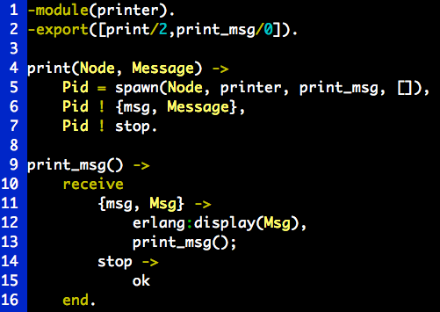

Slide 47
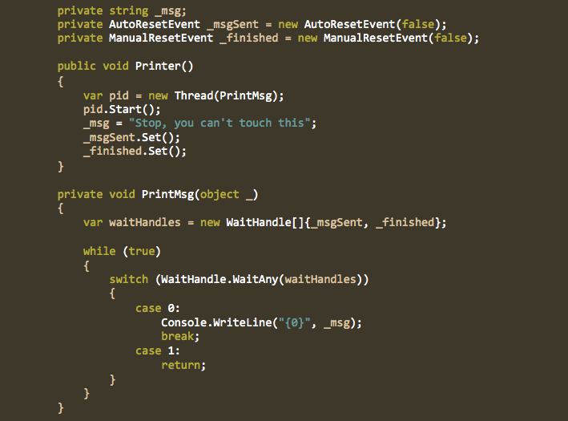

Slide 48
“Any sufficient complicated concurrent program in another language contains an ad-hoc, informally-specified, bug-ridden, slow implementation of half of Erlang.”
Robert Virding, Co-Inventor of Erlang

Slide 49
One .NET 4.0 Thread (allocates one megabyte)
**********
**********
**********
**********
**********
**********
**********
**********
**********
**********
**********
**********
**********
**********
**********
**********
**********
**********
**********
**********
**********
**********
**********
**********
**********
**********
**********
**********
**********
**********
**********
**********
**********
**********
**********
**********
**********
**********
**********
**********
**********
**********
**********
**********
**********
**********
**********
**********
**********
**********
**********
**********
**********
**********
**********
**********
**********
**********
**********
**********
**********
**********
**********
**********
**********
**********
**********
**********
**********
**********
**********
**********
**********
**********
**********
**********
**********
**********
**********
**********
**********
**********
**********
**********
**********
**********
**********
**********
**********
**********
**********
**********
**********
**********
**********
**********
**********
**********
**********
**********
*
One Erlang Process (allocates one kilobyte)
Why -> elsewhere concurrency is painful

Slide 50
Demo
Cheap processes

Slide 51
.net to erlang/OTP
How .NET translates to Erlang

Slide 52
It doesn’t, but here are some correlations we can make

Slide 53
Which is to what
Microsoft World
Erlang World
C#
Framework - .NET
Erlang
Framework - OTP

Slide 54
Super Simple Code
C#
Erlang
public class Calculator
{
public static int AddTwoNumbers(int x, int y)
{
return x + y;
}
}
add_two_numbers(A, B) ->
A + B.

Slide 55
Namespaces
C#
Namespace Company.Team.SubTeam.App.Module
Erlang
Doesn’t have namespaces, uses convention
mortgage_credit:pull(Client).

Slide 56
Think Functions!
C#
Erlang
IEnumerable<T>.Where()
IEnumerable<T>.Select()
IEnumerable<T>.Aggregate()
Thread.Start(), Thread.QueueUserWorkItem()
Console.WriteLine()
lists:filter()
lists.:map()
lists:fold()
spawn(), spawn_link()
io:format()
Module

Slide 57
Classes / Modules
C#
Erlang
Everything has to be in a class in .NET. Not surprising it is an OOP language.
Modules contains sequence definitions and function declarations.
Files must be named the same name of the module

Slide 58
Testing
.NET
Erlang/OTP
MSTest
Nunit
XUnit
eunit (community uses pretty much one tool)

Slide 59
Editors
.NET
Erlang/OTP
Visual Studio
IntelliJ IDEA
Emacs
VIM
Sublime (has erlang plugin)
Atom

Slide 60
Build Tools
.NET
Erlang/OTP
msbuild
Rebar
relx
Make

Slide 61
What Erlang/OTP Replaces in .NET
Keep
Replace
Winforms
WPF
*Web
*Web
REST APIs
Windows Services
Console apps
*It depends

Slide 62
Distributed

Slide 63
Distributed Erlang
Processes pass messages
Works locally or distributed
Allows to change from a local model to a distributed model with no code change
Location Transparency
You don’t think about communicating between computers
Pid (process id carries all the data)

Slide 64
Distributed Erlang
VM – a running Erlang instance - erl command
Node – a VM instance
Cluster – when two or more nodes become aware of each other
Fully connected – every node knows about every other node, they communicate directly with each other

Slide 65
NODE1
NODE3
NODE2
NODE4

Slide 66
Distributed Erlang
Resource Discovery
No single point of failure – It’s a peer-to-peer system
No hardcoded network topology – add resources when you want
Easier scaling – add resources as needed
Ability to run many services in a single node – discovery is location transparent and works well with only one node, makes testing easier
Easier upgrades – bring down old services and start new ones dynamically

Slide 67
demo
Distributed and Hot Code Loading

Slide 68
What we’ve learned exploring erlang

Slide 69
What we learned
6 months for an OOP Engineer to really start to contribute to a project
A non-Unix OOP Engineer add another 3 months
The only way to test Erlang is write Erlang code (we broke our test tools)
Debugging highly distributable systems presents it own set of challenges
Pattern matching in Erlang is awesome

Slide 70
What we learned
Erlang is extremely stable and doesn’t crush under load
Spent a lot of time on automating deployments and how we were going to handle our infrastructure
Our team is excited about exploring Elixr
We have less dependencies
Dialyzer is your friend
Websockets / push notifications a breeze
And lastly…

Slide 71
Web Server
Get angle brackets (html)
ERLANG
Get curly braces (data)
Fetch Data
REST API
Database
Queue
Pub/Sub
Cache
Backend Service
Notes:
We built system like this

Slide 72
ERLANG
Notes:
To this now.

Slide 73
Why Erlang?
@KeithElder
http://keithelder.net
Director, Software Engineering
Quicken Loans
Deck/Demo available @ http://github.com/keithelder

